Slide 1
Article 12 in Scotland
Google Self and the Young Gypsy/Travellers’ Lives Project

Slide 2
Multiple identities and inequality
Race
Ethnicity
Gender
Sexuality
Culture
Social class
Disability
Nationality
Religion
Age
Notes:
As young, female Gypsy/Travellers our multiple identities as well as how and where we experience them is complex. Identity categories we identify with are; gender[being female!], race, age, sexuality, nationality, religion, culture, ethnicity, disability, social class.
These multiple identities are experienced as both privileges and disadvantages dependant on where they happen for us. For example; individually, at school, with friends/family, at work, in our own community, wider society. A constant power imbalance within such interlinking identities can generate particular inequalities for us in shaping our social identities and impacting on our everyday life experiences.
FOR EXAMPLE: “Being refused drinking water whilst on the road”, “Men are usually dominant within the hierarchy of our community” “Unequal access to services in general, especially for us within education as a result of bullying and prejudice regardless of ability. Often we were put in classes for children with additional learning needs even though this did not apply to us. We felt that we were written off immediately as a result of our ethnicity.”

Slide 3
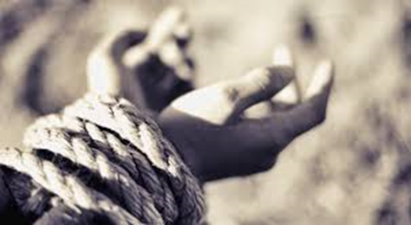
“Asking permission to go to work”
“Surviving over living”
“Justifying where
you’ve been, where you’re going”
“Asking for money”
Notes:
In order for us to challenge oppression using our understanding of Intersectionality, we must first understand where it exists and how it manifests itself.
Having ownership of our project has allowed us to identify our own social justice issues in aspiring to access our rights and to provide us with legitimate ‘status’ within our own community (FOR EXAMPLE: “Older generations within our community come to us for advice”, “Gained respect from our community for the work we have undertaken”, “Changed attitudes in our own community towards being able to sincerely participate in decision making processes”, “ Gained more freedom, independence and trust from family.”
This has also aided our understanding of oppression, what it means, where it happens and the ways in which we can challenge it via our project but also in our own lives.

Slide 4
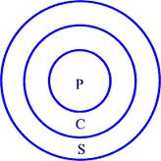
Circles of Oppression
Personal – being judged because of your ethnicity results in a lack of confidence in your own identity.
Cultural – people expressing ignorance towards your culture based on mass media stereotyping.
Structural – being unable to gain equal access to services such as education, health and accommodation as a result of not being favoured by ‘mainstream’ structures.

Slide 5
Google Self: a demonstration
Notes:
In any learning process, the ability to self-reflect is integral to personal development. As YGTL peer educators, we use ‘Google-self’ as a tool to aid the process of self-empowerment by examining self- desires, the progress made in realising these self-desires and how life’s factors [Intersectionality] impacts [both positively and negatively] upon our capacity to achieve them. By becoming skilled in this process, we have been able to understand and make intrinsic links with our own skills, knowledge, experiences and our work within Article 12 in Scotland.
By using this tool on a regular basis we are able to identify where barriers to learning occur, how our desires can change over time and why it can be helpful to plan goals and set timelines for achieving those goals. This has been empowering for us as individuals, as a peer group and as managers of our own project. Most importantly, it has helped us develop a strong self- awareness of where we want to be in terms of our current/future personal and professional needs coupled with an increased capacity to identify where multiple discrimination exists for us.

Slide 6
To be free from oppression
Developing awareness raising workshops to influence cultural change.
Being unable to gain equal access to services as a result of not being favoured by the ‘mainstream’.
Peer learning and support.
Being judged as a
result of ethnicity.
Writing media audit reports based on discriminatory press.
Via our project work, participating in decision making processes that affect our community across Scotland.
Participating in groups where you are not judged.
People expressing ignorance towards your culture based on mass media stereotyping.

Slide 7
To gain accreditation for our work
Group support and equal understanding of a common goal.
Work experience/
increased
work load.
Family expectations.
To feel ‘legitimate’ in mainstream society.
Funding/research/ideas.
Maintaining and creating positive partners.
Gaining equal access to opportunities.
Personal lack of confidence.
Access to culturally sensitive education.
Challenging structural inequalities to recognise our contributions as active citizens.

Slide 8
Having developed our understanding of intersectionality throughout the last 3 years, we are now at the next stage of challenging the structural inequalities we face. To do this, we are going to need support from academic institutions, like yourselves, to help us create an accreditation for the work we carry out on a daily basis on behalf of our community. If WE are to work in sincere collaboration, using our understanding of intersectionality, how can we work together to create something that will truly challenge oppression?

